Slide 1
Community Development
August 16, 2010
Summer 2010 Youth Programming Report
Community Outreach & Education
Recreation & Fitness
Notes:
Summer is truly one of my favorite times in Community Development due in large part to the hundreds of children we have on campus. This time is especially busy for Recreation and Fitness and Community Outreach and Education who provide constant youth programming throughout the summer months.

Slide 2
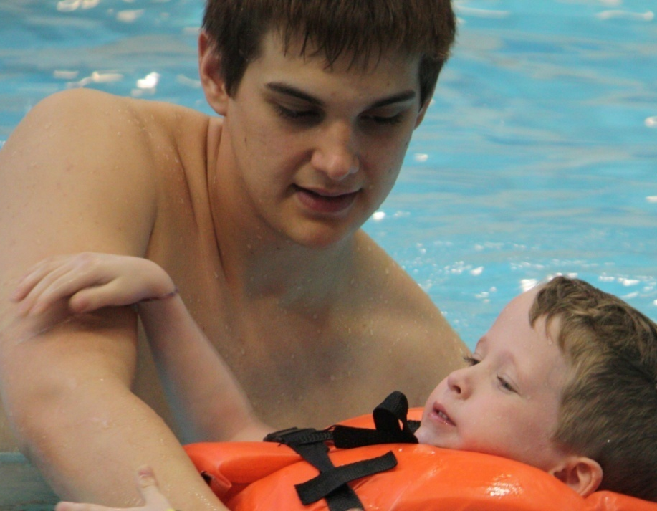
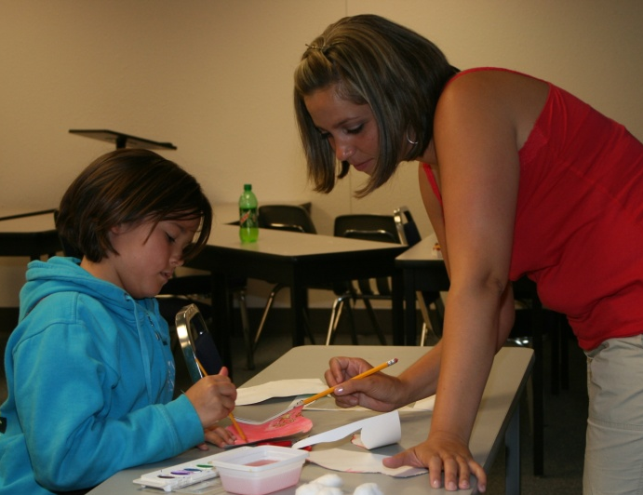
COMMUNITY DEVELOPMENT SUMMER YOUTH PROGRAMS
Community Outreach and Education
College for Kids and Teens
Music Theater Camps/Academy
Recreation and Fitness
Learn to Swim
Sports Camps
Snoopy Squad and Peanuts Gang
Swim Camps
Junior Lifeguard
Swim Team
Notes:
Community Outreach and Education operates two programs -- College for Kids and Teens and the Music Theater Camps and Academy, which are academic enrichment programs.
Recreation and Fitness operates several programs: Our Learn to swim classes are American Red Cross lessons for ages 18 months through adult. Sports Camps are ½ day camps in a variety of sports such as T-ball, baseball, soccer, basketball and tennis. (Others include golf, swimming, cheer and dance and football.) Snoopy Squad and Peanuts Gang are two hour mini-camp that provide a swimming lesson, activities in the gym and craft time. Snoopy squad is for ages 3-5 and Peanuts Gang is for ages 6 to 9. Swim Camps are competitive swim clinics for ages 6 to 14. Junior Lifeguard is for ages 11 to 15 and is way for Recreation and Fitness to transition students from swimming lessons to the lifeguard training program. Our Swim Team offers weekly structured workouts and swim meets for ages 5 to 15.

Slide 3
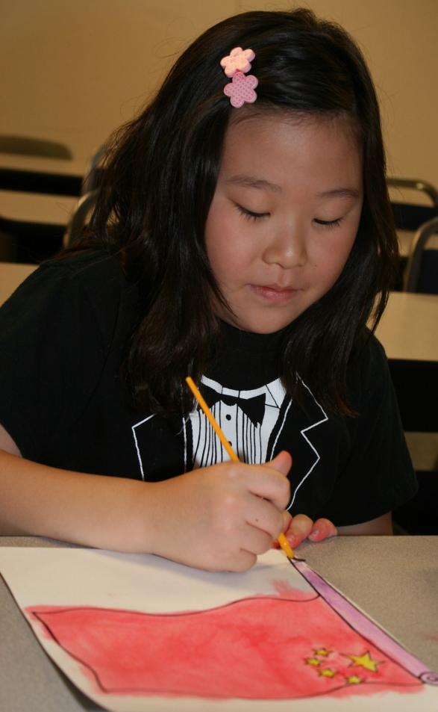
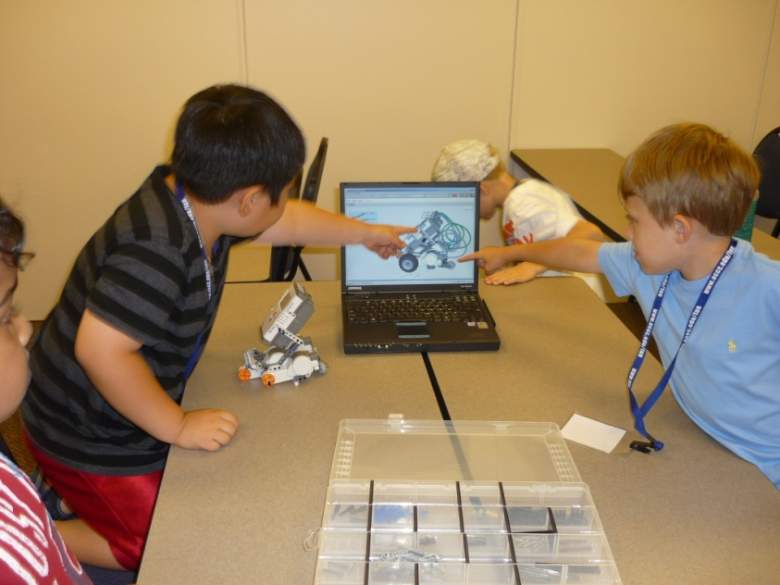
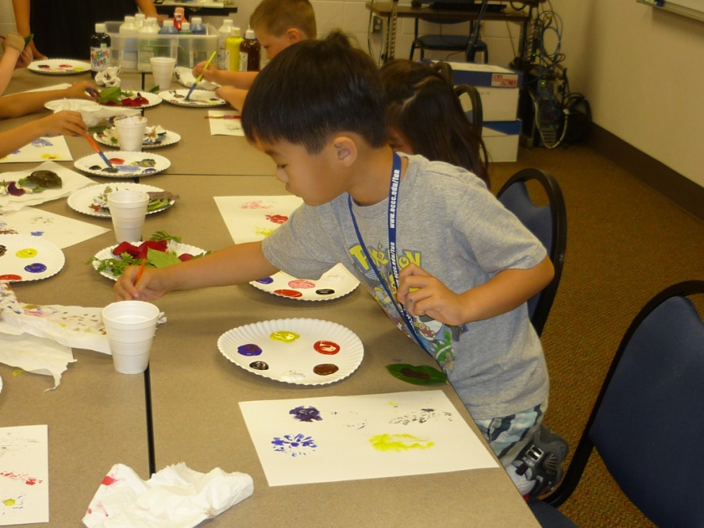
COMMUNITY OUTREACH AND EDUCATION
College for Kids and Teens
Grades 1st through 8th
331 Students
1,813 Enrollments
Notes:
College for Kids and Teens serves first through eighth grades. The program began June 7th and ran through the end of July. The program served over 300 students this summer from throughout the metro area and beyond. Our total enrollment for the summer was over 1,800. This was a 100% increase over the previous year. The number of individual students attending our College for Kids Summer Programs has also increased nearly 12% this year.

Slide 4
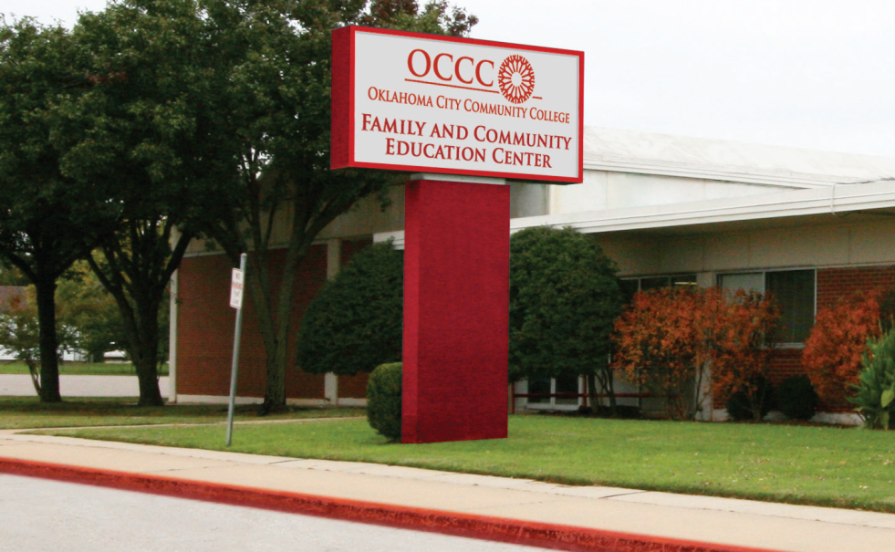
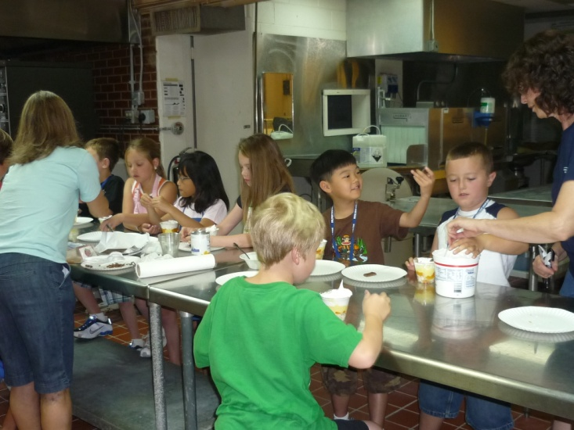
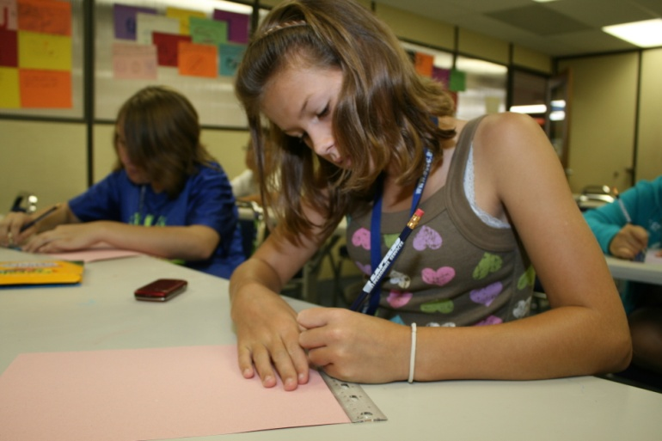
COMMUNITY OUTREACH AND EDUCATION
College for Kids and Teens Program Relocation
Family & Community Education Center
Dedicated Classrooms
Cafetorium with Kitchen
Auditorium
Gymnasium
Stage
Notes:
The Community Outreach & Education wing of the FACE Center was completed this year and all administrative offices, as well as the College for Kids classes started full operation at the new facility this Summer. The classrooms allowed the program the freedom to organize and schedule classes as needed to maximize usage. This allowed for a large increase in enrollments without competing for campus space.

Slide 5
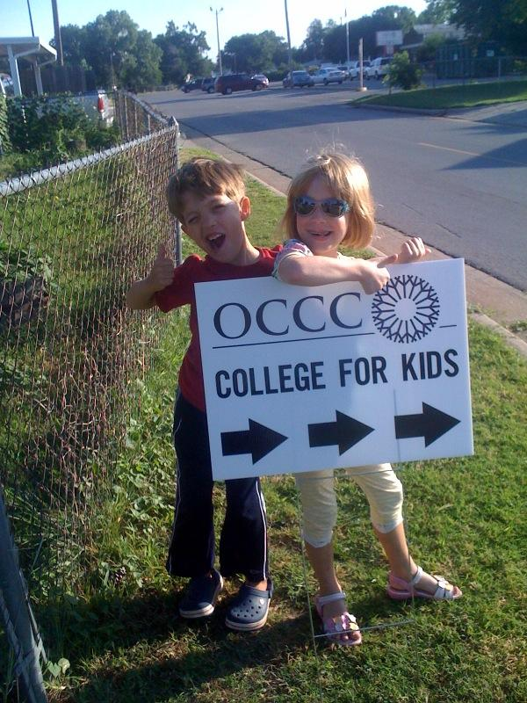
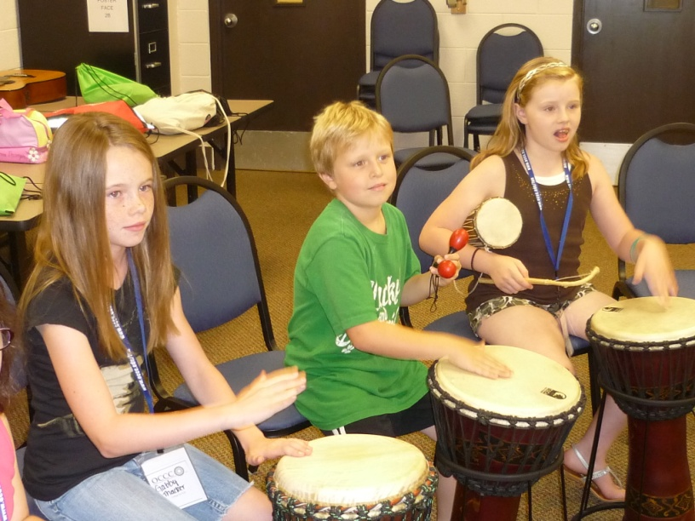
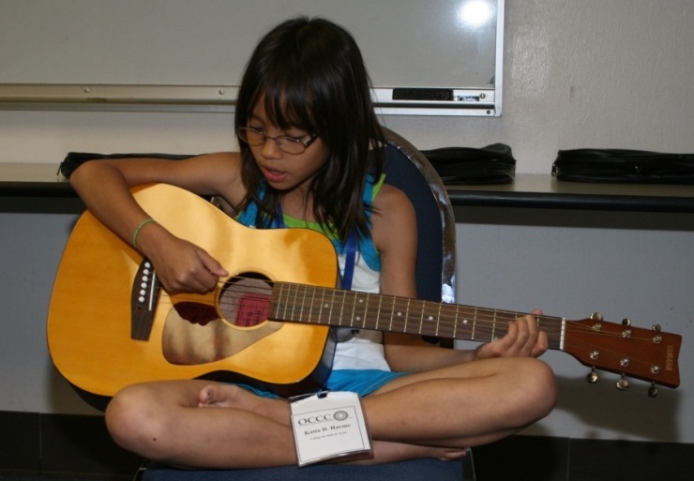
COMMUNITY OUTREACH AND EDUCATION
Musical Theater Camps and Academy
Musical Theater Camps
Week 1 - Grades 1-3 (16)
Week 3 - Grades 4&5 (18)
Musical Theater Academy
Weeks 5&6 - Grades 6-8 (30)
Notes:
Our most popular classes continue to be our Music Theater Camps and Academy. This year we had three camps for Grades first through fifth. Our first camp was a production of “Spaced Out” for first through third graders. The fourth and fifth graders performed “Cinderella.” And our Music Theater Academy, for grades sixth through eighth, presented a Broadway junior production: “Thoroughly Modern Millie” about the Roaring 20s.

Slide 6
COMMUNITY OUTREACH AND EDUCATION
Enrollment By Division
Notes:
The most popular classes based on enrollment were in the creative arts division. This section includes both our performing and visual arts classes. Our Humanities and Social Science Classes included reading, creative writing, various book clubs, leadership, language, and history. This year our own Martin Ramirez taught a Youth in Government class including a trip to the Oklahoma Capitol. Some of our more popular science classes included CSI, Backyard biology, chemistry and physics. While our computer applications classes were popular our math classes continue to have low enrollment.

Slide 7
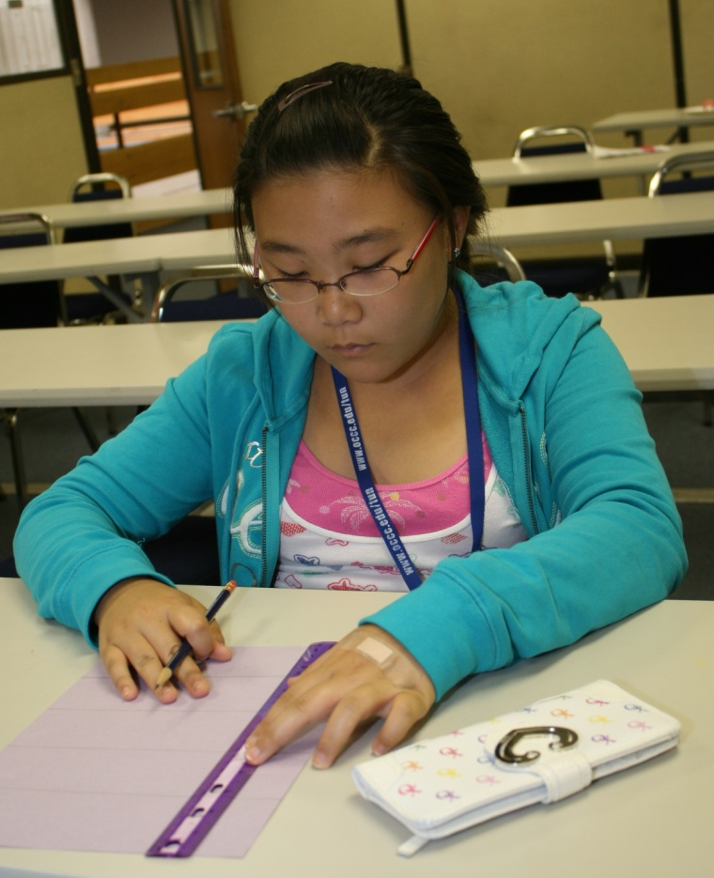
COMMUNITY OUTREACH AND EDUCATION
Summer 2010 Program Revenue
Notes:
Community Outreach and Education is expecting a 21% increase in revenue over last year. We were able to cover our costs including supplies and salaries for instructors and counselors by 80%. This year continues the upward trend of momentum pushing College for Kids to new heights. Parents were able to take advantage of a new package discount offered this year encouraging students to sign up in additional sections.
Summer 2008 Revenue $25,794.00
Summer 2009 Revenue $43,788.41
Summer 2010 Revenue $53,000.00 (based on minimum estimates)
Total cost: $61,700 Personnel & $3,800 Supplies

Slide 8
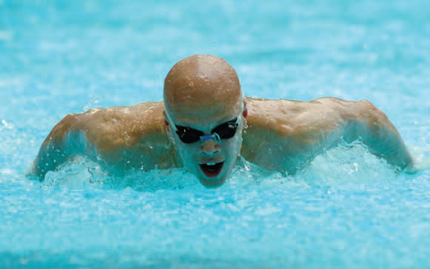
RECREATION AND FITNESS
Recreation and Fitness offered a variety of aquatic programs, sports and fitness camps.
Sports Camps,Fitkids & Camp-Rec
Snoopy Squad & Peanuts Gang
Swim Team
Jr. Lifeguard
Learn to Swim
Swim Camps
Notes:
Recreation and Fitness classes and camps began June 1 and ended August 6. Camps focused on specific Sports, overall Fitness or just plain Fun. In addition to the camps, swim lessons and swim team were also offered.

Slide 9
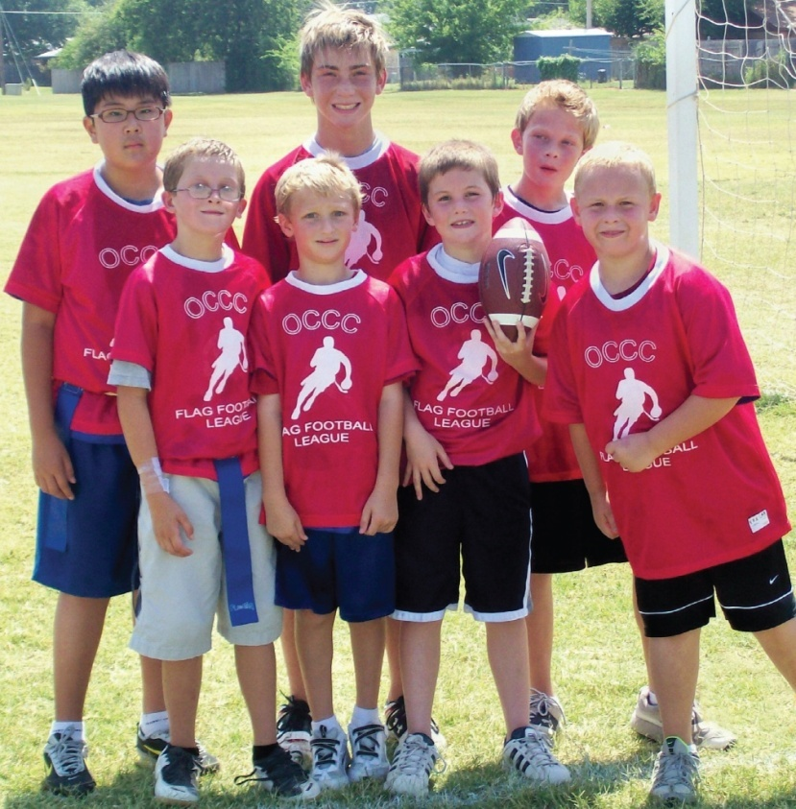
RECREATION AND FITNESS
2010 Highlights
Sports Camp up 57%
Camps offered during Holiday weeks
Before/After Care
Camps promote Healthy Lifestyles
Fitkids
Camp-Rec
Notes:
This year saw the addition of all day FitKids camps offered the first week of June and the week of the July 4th Holiday. Before and After Camp Care was offered to accommodate the working schedules of parents. The campers had multiple camps to choose from each week including the continuation of the Sports and Fitkids camps plus the new Camp-Rec, for children that wanted to be active, but were not interested in a specific sport.

Slide 10
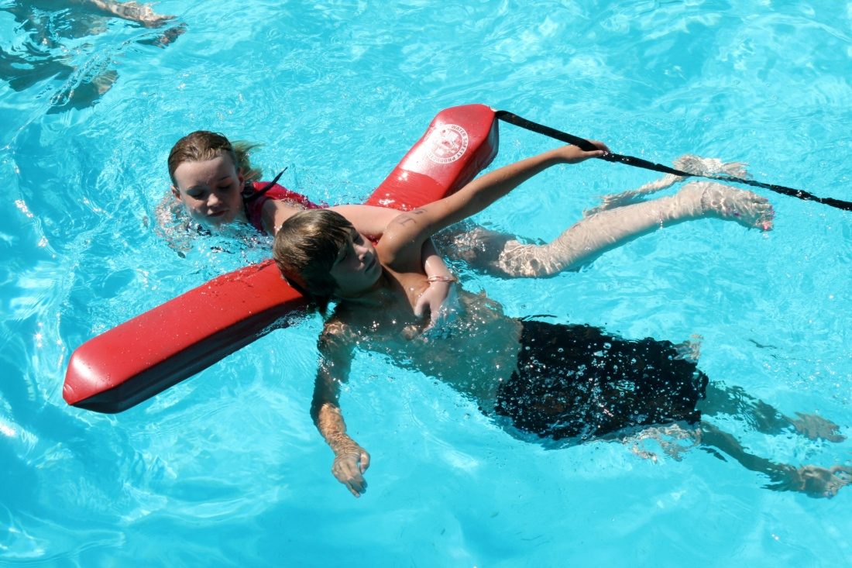
RECREATION AND FITNESS
Junior Lifeguard
Junior Guard Class
Grown 13% this year
Junior Guard Camp
Lifeguard Games Competition
3rd & 4th Place in several events
5th Place Overall
Notes:
Our Junior Lifeguarding classes increased enrollment this year. The Junior Guard class helps develop the strength and endurance in the water and also teaches personal safety skills, basic water safety awareness and injury prevention as well as an introduction into lifeguard training.
Our Junior Lifeguard camp ends with class participants competing at the annual Lifeguard games held at White Water Bay. This year the Junior Guard team placed third in a simulated scanning event, and 4th place in Deep Water tug of war, The Rescue Relay and Spinal Injury Management.

Slide 11
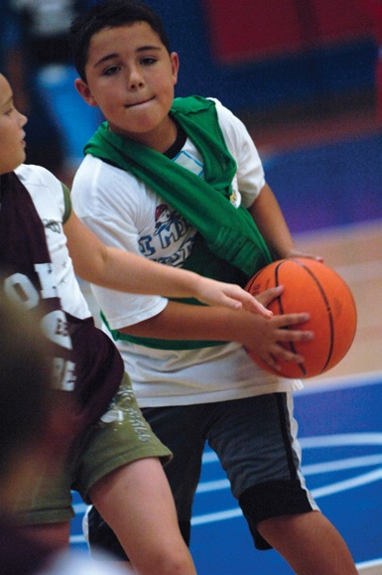
RECREATION AND FITNESS
2010 Enrollment By Program
Notes:
Recreation & Fitness saw a 18.7% increase in their enrollment over 2009 with more than 1,900 participants. Sports Camps enrollments alone had an increase of over 57 percent. Learn to Swim remains highly popular and limited only by the number of instructors available. Preschool and Beginners sections have been full all Summer. Capacity is expected to increase as more instructors are added.

Slide 12
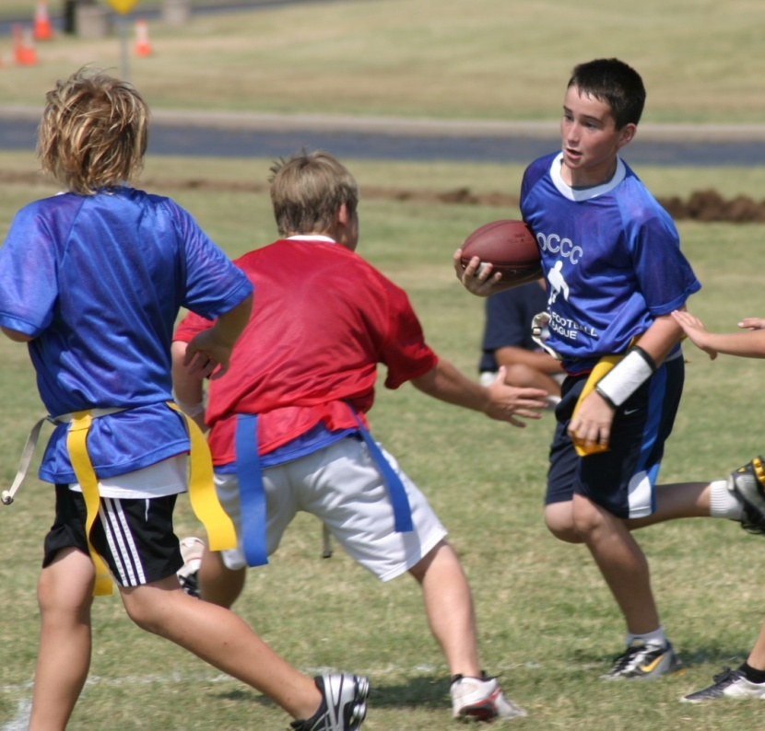
RECREATION AND FITNESS
Summer 2010 Program Revenue
Notes:
2008 -- $46,605 2009--$62,966 2010--$68,424
Recreation and Fitness also saw an 8.7% increase in revenue over last year

Slide 13
Questions?
Steven Bloomberg
Vice President for Community Development
Oklahoma City Community College
7777 S. May Avenue
Oklahoma City, OK 73159
(405) 682-7814
Cell: (405) 761-9925
sbloomberg@occc.edu
www.occc.edu

